Slide 1
Lecture Title: Recursion
Course Code: CSC 2211
Course Title: Algorithms
Dept. of Computer Science
Faculty of Science and Technology
Lecture No: | 03 | Week No: | 03 | Semester:
Lecturer:

Slide 2
Lecture Outline
Divide and Conquer
Recurrences in Divide and Conquer and methodologies for recurrence Solutions
Repeated Backward Substitution Method
Substitution Method
Recursion Tree (Next Week)
Master Method (Next Week)

Slide 3
The divide- and- conquer design paradigm
• Divide and conquer is just one of several powerful techniques for algorithm design.
• Divide- and- conquer algorithms can be analyzed using recurrences and the master method (so practice this math).
• Can lead to more efficient algorithms

Slide 4
The divide- and- conquer design paradigm
1. Divide the problem (instance) into subproblems.
2. Conquer the subproblems by solving them recursively.
3. Combine subproblem solutions.

Slide 5
The divide- and- conquer design paradigm
Example: merge sort
1. Divide: Trivial (array is halved).
2. Conquer: Recursively sort 2 subarrays.
3. Combine: Linear- time merge.
Recurrence for merge sort
Let T( n ) = Time required for size n
T( n ) =
Sub-problem
Size (n/2)
2
*
T( n / 2)
+
O( n)
Number Of Subproblems
Time required for each Subproblem
Work Dividing and Combining
*
+

Slide 6
The divide- and- conquer design paradigm
Binary search
Find an element in a sorted array:
1. Divide: Check middle element.
2. Conquer: Recursively search 1 subarray.
3. Combine: Trivial.
Recurrence for binary search
T( n) =
1
*
T( n / 2)
+
Θ(1)
Number Of Subproblems
Time required for each Subproblem
Work Dividing and Combining
*
+

Slide 7
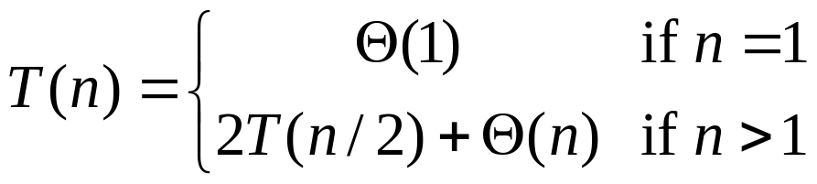
Recurrences
Running times of algorithms with recursive calls can be described using recurrences.
A recurrence is an equation or inequality that describes a function in terms of its value on smaller inputs.
For divide and conquer algorithms:
Example: Merge Sort

Slide 8
Solving Recurrences
Repeated (backward) substitution method
  Expanding the recurrence by substitution and noticing a pattern (this is not a strictly formal proof).
Substitution method
  guessing the solutions
  verifying the solution by the mathematical induction
Recursion-trees
Master method
  templates for different classes of recurrences

Slide 9
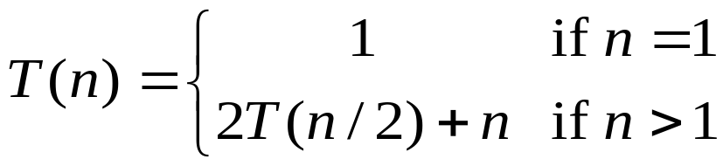
Repeated Substitution
Let’s find the running time of the merge sort
T(n) = 2T(n/2) + n substitute
= 2(2T(n/4) + n/2) + n expand
= 2²T(n/4) + 2n substitute
= 2²(2T(n/8) + n/4) + 2n expand
= 2³T(n/8) + 3n observe pattern
= 2³T(n/2³) + 3n observe pattern
T( n ) = 2^{k}T(n/2^{k}) + kn
= n 1 + n lg n
= n + n lg n
assume 2^{k-1}< n ≤ 2^{k}.
So upper bound for k is
n = 2^{k}
K = log₂n = lg n
T(n) = O(nlgn)

Slide 10
Repeated Substitution Method
The procedure is straightforward:
Substitute, Expand, Substitute, Expand, …
Observe a pattern and determine the expression after the k-th substitution.
Find out what the highest value of k (number of iterations, e.g., lg n) should be to get to the base case of the recurrence (e.g., T(1)).
Insert the value of T(1) and the expression of k into your expression.

Slide 11
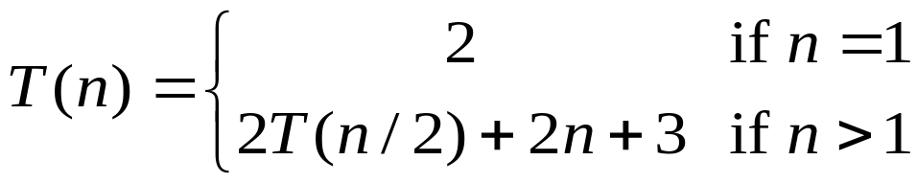

Another Example…
assume 2^{k-1}< n ≤ 2^{k}.
So upper bound for k is
n = 2^{k}
K = log₂n = lg n
T(n) = 2T(n/2) + 2n + 3 substitute
= 2(2T(n/4) + n + 3) + 2n +3 expand
= 2²T(n/4) + 4n + 2x3 + 3 substitute
= 2²(2T(n/8) + n/2 + 3) + 4n + 2x3 + 3 expand
= 2³T(n/2³) + 2x3n + 3x(2²+2¹+2⁰) observe pattern
T(n) = 2^{k}T(n/2^{k}) + 2kn + 3
= 2^{k}T(n/2^{k}) + 2nk + 3 (2^{k}-1)
= nT(n/n) + 2n lg n + 3(n - 1)
= 2n+2n lg n + 3n - 3
= 5n + 2n lg n – 3
T(n) = O(nlgn)

Slide 12
Substitution Method
The substitution method to solve recurrences entails two steps:
  Guess the solution.
  Use induction to prove the solution.
Example:
  T(n) = 4T(n/2) + n

Slide 13
…Substitution Method
T(n) = 4T(n/2) + n
1) Guess T(n) = O(n³), i.e., T(n) is of the form cn³
2) Prove T(n) ≤ cn³ by induction
T(n) = 4T(n/2) + n recurrence
≤ 4c(n/2)³ + n induction hypothesis
= 0.5cn³ + n simplify
= cn³ – (0.5cn³ – n) rearrange
≤ cn³ if c>=2 and n>=1
Thus T(n) = O(n³)

Slide 14
...Substitution Method
Tighter bound for T(n) = 4T(n/2) + n:
Try to show T(n) = O(n²)
Prove T(n) ≤ cn² by induction
T(n) = 4T(n/2) + n
≤ 4c(n/2)² + n
= cn² + n
≤ cn² ?

Slide 15
...Substitution Method
What is the problem? Rewriting
  T(n) = O(n²) = cn² - (something positive)
As T(n) ≤ cn² does not work with the inductive proof.
Solution: Strengthen the hypothesis for the inductive proof:
  T(n) ≤ (answer you want) - (something > 0)

Slide 16
...Substitution Method
Fixed proof: strengthen the inductive hypothesis by subtracting lower-order terms:
Prove T(n) ≤ cn² - dn by induction
T(n) = 4T(n/2) + n
≤ 4(c(n/2)² – d(n/2)) + n
= cn² – 2dn + n
= (cn² – dn) – (dn – n)
≤ cn² – dn if d ≥ 1

Slide 17
Don’t miss the next class !!!!!!!!!!!!!!!!!!

